Slide 1
MAX FLOW-MIN CUT THEOREM

Slide 2
CONTENTS
INTRODUCTION
HISTORY
PREREQUISITES
RELATIONS BETWEEN FLOWS AND CUTS
MAXIMUM-FLOW PROBLEM AND MINIMUM CUT PROBLEM
MAX-FLOW MIN-CUT THEOREM
FORD-FULKERSON ALGORITHM
EDMONDS-KARP ALGORITHM
APPLICATIONS

Slide 3
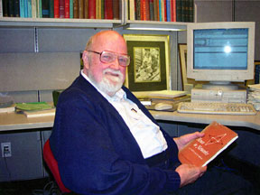
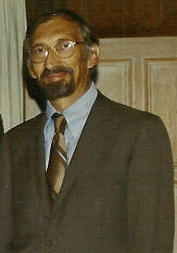
History
The max-flow min-cut theorem was proven by L.R. Ford, Jr. and D.R. Fulkerson in 1956
Ford and Fulkerson mentioned that the maximum flow problem was formulated by T. E. Harris as follows:
Consider a rail network connecting two cities by way of a number of intermediate cities, where each link of the network has a number assigned to it representing its capacity. Assuming a steady state condition, find a maximal flow from one given city to the other

Slide 4

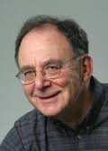
Richard M Karp
Jack R Edmonds

Slide 5
PREREQUISITES
Single source-Single sink network
Capacitated network
Outset
Inset
Flow (feasible)
Value of flow
Maximum flow
Cuts

Slide 6
PREREQUISITES
A single source-single sink network is a connected digraph that has a distinguished vertex called source s , with nonzero outdegree and a distinguished vertex called the sink t, with nonzero indegree.
It is often referred to as an s-t network.
A capacitated network is a connected digraph such that each arc e is assigned a non negative weight cap(e), called the capacity of arc e.

Slide 7
The out-set of v, denoted as Out(v), is the set of all arcs that are directed from vertex v.
Out(v) = {e ε En | tail(e) = v}
The in-set of v, denoted as In(v), is the set of all arcs that are directed to vertex v.
In(v) = {e ε En | head(e) = v}
For any two vertex subsets X and Y of a digraph N, let <X,Y> denote the set of all arcs in N that are directed from a vertex in X to a vertex in Y.
<X,Y> = {e ε En | tail(e) ε X and head(e) εY}

Slide 8
FLOW
Let N be a capacitated s-t network. A feasible flow f in N is a function f:E_{N}→R+ that assigns a non negative real number f(e) to each arc e such that
f(e)<=cap(e), for every arc e in network N.
∑_{e} _{ε In(v)} f(e) = ∑_{e} _{ε Out(v)} f(e) ,for every vertex v in network N , other than source s and sink t. This property is called the conservation-of-flow condition.

Slide 9
The value of flow f in a capacitated network, denoted val(f), is the net flow leaving the source s, i.e.,
val(f) = ∑ _{e} _{ε Out(s)} f(e) - ∑ _{e} _{ε In(s)} f(e)
A maximum flow f* in a capacitated network N is a flow in N having the maximum value, i.e., val(f)<=val(f*), for every flow f in N.

Slide 10
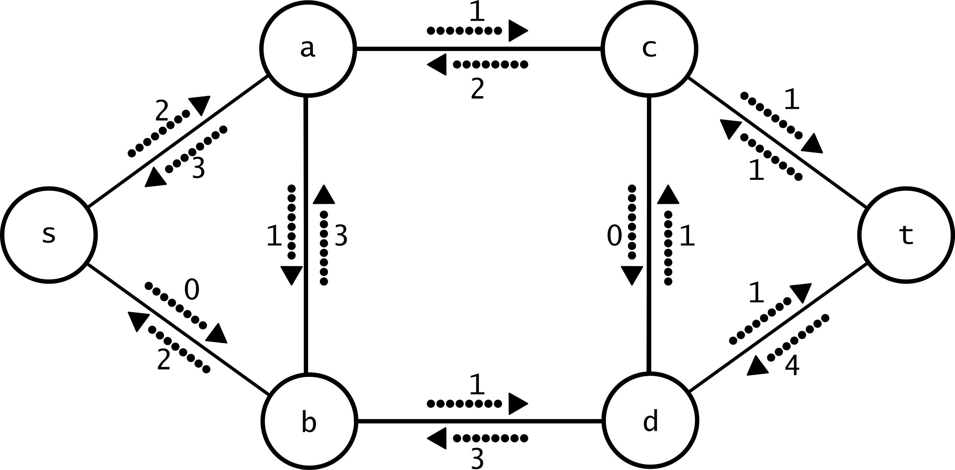

Slide 11
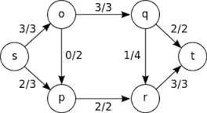

Slide 12
CUT
Let N be an s-t network, and let V_{s} and V_{t} form a partition of V_{N} such that source s ε V_{s} and sink t ε V_{t}. Then the set of all arcs that are directed from a vertex in set V_{s} to a vertex in set V_{t} is called an s-t cut of network N and is denoted < V_{s} , V_{t} >.
The capacity of a cut < V_{s} , V_{t} >, denoted as cap< V_{s} , V_{t} >, is the sum of the capacities of the arcs in cut < V_{s} , V_{t} >.i.e.,
cap< V_{s} , V_{t} > = ∑ _{e} _{ε < Vs ,Vt >} cap(e).
A minimum cut of a network N is a cut with the minimum capacity.
An s-t quasi-path in a network N is an alternating sequence of vertices and arcs that forms an s-t path in the underlying graph of N.

Slide 13
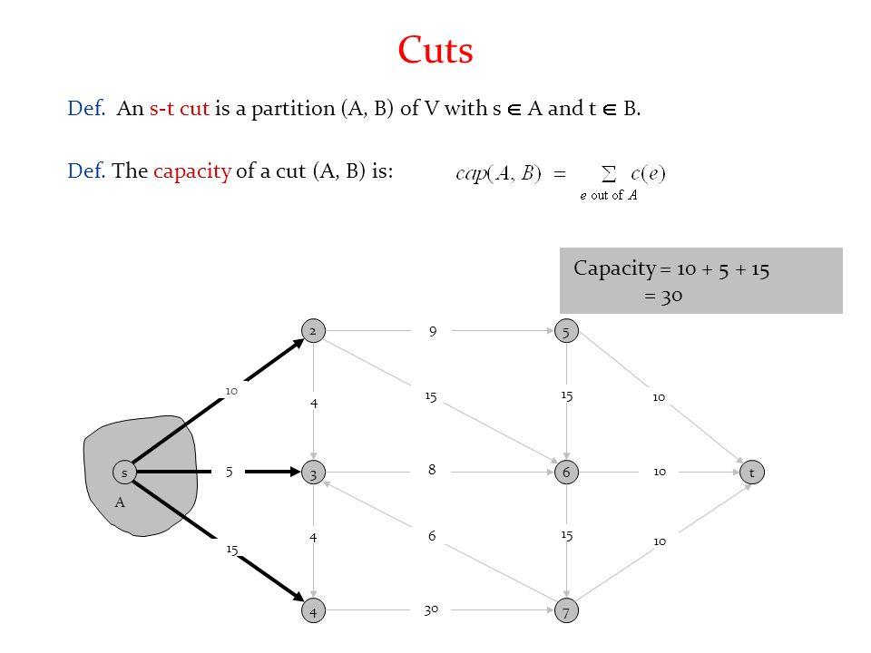

Slide 14
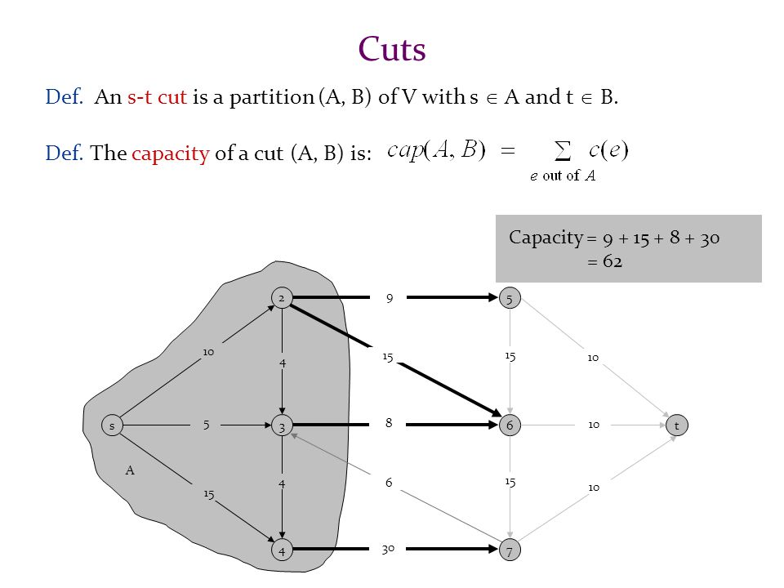

Slide 15
Proposition 1
Let < V_{s} ,V_{t} > be an s-t cut of a network N. Then every directed s-t path
in N contains at least one arc in < V_{s} ,V_{t} >.
Let P=< s = v₀ , v₁ , v₂ , … v_{l} = t> be the vertex sequence of a directed s-t path in network N.
Since s ε V_{s} and t ε V_{t} ,there must be a first vertex V_{j} on this path that is in set V_{t} .
Then the arc from vertex V_{j-1} to V_{j} is in < V_{s} ,V_{t} >.

Slide 16
Lemma
Let < V_{s} ,V_{t} > be any s-t cut of an s-t network N. Then
U_{v} _{ε Vs} Out(v)= < V_{s} ,V_{s} >U < V_{s} ,V_{t} > and
U_{v} _{ε Vs} In(v)= < V_{s} ,V_{s} >U < V_{t} ,V_{s} >
PROOF:
For any vertex v ε V_{s} ,each arc directed from v is either in < V_{s} ,V_{s} > or in < V_{s} ,V_{t} > .
Similarly ,each arc directed to vertex v is either in < V_{s} ,V_{s} > or in < V_{s} ,V_{t} >.

Slide 17
Proposition 2
Let f be a flow in an s-t network N, and let < V_{s} ,V_{t} > be any s-t cut of N.
Then val(f)= ∑ _{e} _{ε < Vs ,Vt >} f(e)- ∑ _{e} _{ε < Vt ,Vs >} f(e)
PROOF
By definition, val(f)= ∑ _{e} _{ε Out(s)} f(e)- ∑ _{e} _{ε In(s)} f(e), and by the conservation of flow, ∑ _{e} _{ε Out(v)} f(e)- ∑ _{e} _{ε In(v)} f(e) = 0 for every v ε V_{s} other than s. Thus,
Val(f)= ∑_{v ε Vs} (∑ _{e} _{ε Out(v)} f(e)- ∑ _{e} _{ε In(v)} f(e))
=∑_{v ε Vs} ∑ _{e} _{ε Out(v)} f(e) - ∑_{v ε Vs} ∑ _{e} _{ε In(v)} f(e)
∑_{v ε Vs} ∑ _{e} _{ε Out(v)} f(e)= ∑ _{e} _{ε < Vs ,Vs>} f(e)- ∑ _{e} _{ε < Vs ,Vt >} f(e) (by lemma)
∑_{v ε Vs} ∑ _{e} _{ε In(v)} f(e)= ∑ _{e} _{ε < Vs ,Vs>} f(e)- ∑ _{e} _{ε < Vt ,Vs >}

Slide 18
Proposition 3
Let f be any flow in an s-t network N, and let < V_{s} , V_{t} > be any s-t cut. Then
val(f)<=cap < V_{s} , V_{t} >
PROOF:
We know that
val(f)= ∑ _{e} _{ε < Vs ,Vt >} f(e)- ∑ _{e} _{ε < Vt ,Vs >} f(e)
<= ∑ _{e} _{ε < Vs ,Vt >} cap(e)- ∑ _{e} _{ε < Vt ,Vs >} f(e)
= cap < V_{s} , V_{t} >- ∑ _{e} _{ε < Vt ,Vs >} f(e)
<=cap < V_{s} , V_{t} >.

Slide 19
COROLLARY - 1
Let f be a flow in an s-t network N and K an s-t cut, and suppose that val(f) = cap(K). Then flow f is a maximum flow in network N, and cut K is a minimum cut.
Proof:
Let f^ be any feasible flow in network N.
The maximality of flow f is implied by the previous proposition and the premise, as follows.
val(f^)<=cap(K) = val(f).

Slide 20
COROLLARY - 2
Let < V_{s} , V_{t} > be an s-t cut in a network N ,and suppose that f is a flow such that
f(e)= cap(e) if e ε < V_{s} , V_{t} >
= 0 if e ε < V_{t} , V_{s} >
Then f is a maximum flow in N, and < V_{s} , V_{t} > is a minimum cut.
Proof:
By the previous proposition we get val(f) = cap < V_{s} , V_{t} >.
And by the corollary if val(f)=cap < V_{s} , V_{t} > ,then f is a maximum flow in N, and < V_{s} , V_{t} > is a minimum cut.

Slide 21
f – AUGMENTING PATH
Let f be a flow in an s-t network N. An f-augmenting path Q is an s-t quasi-path in N such that the flow on each forwaΔrd arc can be increased, and the flow on each backward arc can be decreased.
Thus for each arc e on an f-augmenting path Q,
f(e) < cap(e) , if e is an forward arc
f(e) > 0 , if e is an backward arc

Slide 22
For each arc e on a given f-augmenting path, let Δ_{e} be
Δ_{e} = cap(e) – f(e), if e is a forward arc
= f(e) , if e is a backward arc
Where Δ_{e} is called the slack on arc e.
It’s the largest possible increase in the flow in an forward arc.
It’s the largest possible decrease in the flow in an backward arc.
Δ_{e} disregards conservation of flow.

Slide 23
By conservation of flow the change in the flow on the arcs of an augmenting flow path must be of equal mangnitude.
So the maximum allowable change in the flow on an arc in the quasi-path Q is Δ_{Q}
Δ_{Q} = min_{e ε Q} {Δ_{e} s}

Slide 24
Flow Augmentation
Let f be a flow in a network N ,and let Q be
an f-augmenting path with minimum Δ_{Q} on it’s arcs. Then the augmented flow f given by
f(e)= f(e)+ Δ_{Q} //if e is an forward arc ofQ
f(e)- Δ_{Q}//if e isan backward arc ofQ
f(e)

Slide 25
Proof:
Clearly ,0≤ f^(e) ≤ cap(e) by the definition of Δ_{Q} .
The only vertices through which the net flow changes are the vertices on the augmenting path Q.
For a given vertex v on augmenting path Q, the two arcs of Q that are incident on v are configured.(ex)
The net flow into or out of vertex v does not change( conservation of flow property).
The flow has increased by Δ_{Q} .
The only arc incident on source s whose flow has changed is the first arc e₁ of augmenting path Q.
f^(e₁) = f(e₁) + Δ_{Q} (e1 is a forward arc)
f^(e₁) = f(e₁) - Δ_{Q} (e1 is a backward arc)
In either case,
val(f^)
= ∑ _{e} _{ε Out(s)} f^ (e)- ∑ _{e} _{ε In(s)} f^ (e)
= Δ_{Q} + val(f)

Slide 26
Characterization of Maximum Flow
Theorem:
Let F be a flow in a network N. Then f is a maximum flow in network N if and only if there does not exits an f-augmented path.

Slide 27
Proof:
Necessity(=>)Suppose that f is a maximum flow in network N. Then by (previous proposition), there is no f-augmenting path.
Sufficiency(<=)Suppose that there does not exist an f-augmenting path in network N.
Consider the collection of all quasi paths that start at vertex s.(point to be added)
Let V_{s} be the union of vertex-sets of these quasi paths.

Slide 28
Since there is no f-augmenting path,it follows sink t ! ε V_{s.}Let V_{t} =V_{N}-V_{s},
Then <V_{s},V_{t}> is an s-t cut of network N.
Thus
f(e)= cap(e) e ε <V_{s},V_{t}>
0 e ε <V_{t},V_{s}>
Hence f is a maximum flow ,by corollary 13.1.8(check this)

Slide 29
Max-Flow Min-Cut Theorem:
Theorem:
For a given network, the value of maximum flow is equal to the capacity of the minimum cut.

Slide 30
Ford-Fulkerson Algorithm
Input: an s-t network N
Output: a maximum flow f* in network N
[Initialization]
For each arc e in network N
f*(e)=0
[Flow Augmentation]

Slide 31
While there exist an f* augmeenting path in network N
Find an f* augmenting path Q
for each arc e of augmenting path in network N
If e is a forward arc
f*(e)=f*(e)+ Δ_{Q}
Else [e is a backward arc]
f*(e)=f*(e)- Δ_{Q}
Return flow f*

Slide 32
Edmonds – Karp Algorithm
The Edmonds – Karp algorithm finds the f-augmenting path as a shortest path from s to t in graph G using breadth-first search.
The time complexity of this algorithm is O(V*E²)
The time complexity of Ford-Fulkerson algorithm is O(E|f*|)
f*-maximum flow in the network
E-edge set

Slide 33
Applications
Maximum matching in a bipartite graph
Image Segmentation problem
Traffic regulation
Airline Scheduling

Slide 34
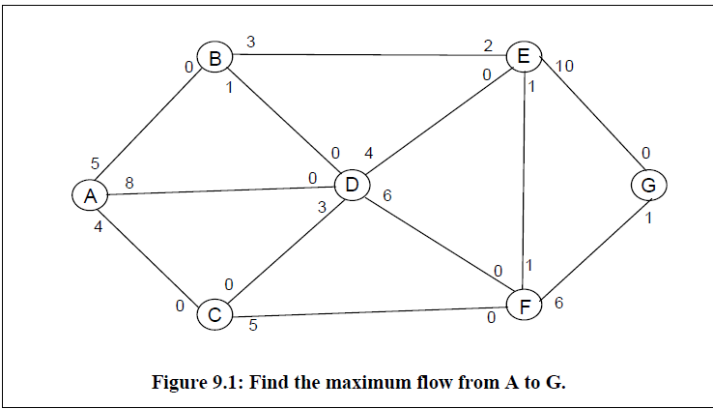
Problem:
Find the maximum flow from A to G.

Slide 35
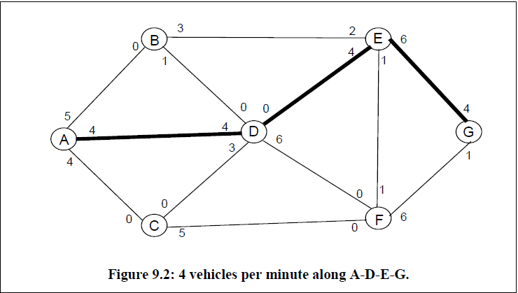

Slide 36
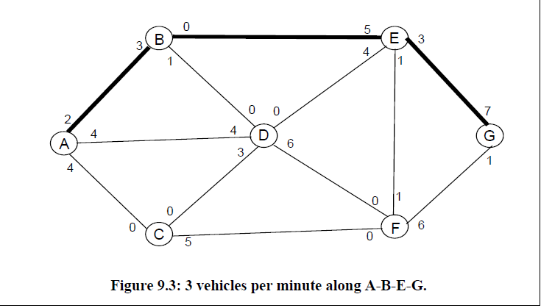

Slide 37
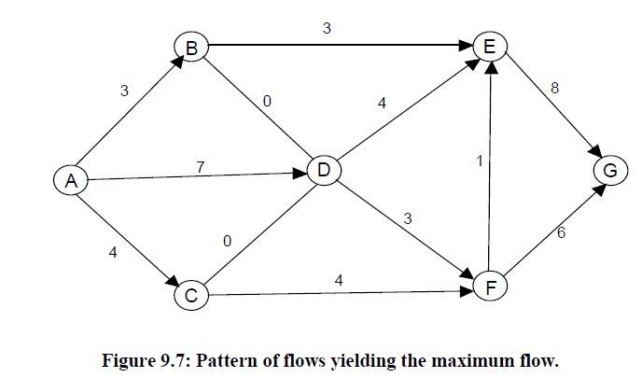

Slide 38
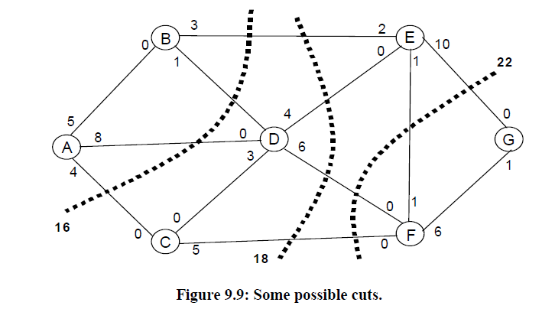

Slide 39
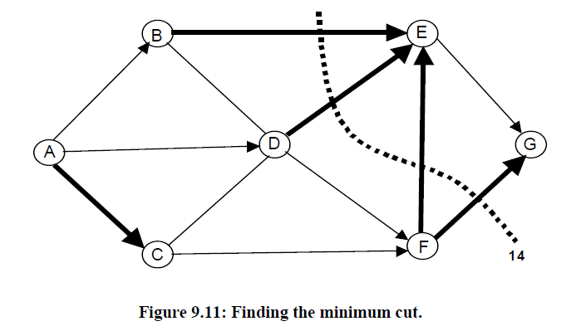

Slide 40
References:
Jonathan Gross and Jay Yellen, “Graph Theory and its Applications”, CRC Press, 2006.
Bondy J A, Murty U S R, “Graph Theory”, Springer, 2013.
Thomas H Cormen, Charles E Leiserson and Ronald L Rivest, “Introduction to Algorithms”, MIT Press, 2010.

Slide 41


Slide 42


